Slide 1
CMSC 28100 Introduction to Complexity Theory Autumn 2025 Instructor: William Hoza
⏳

Slide 2


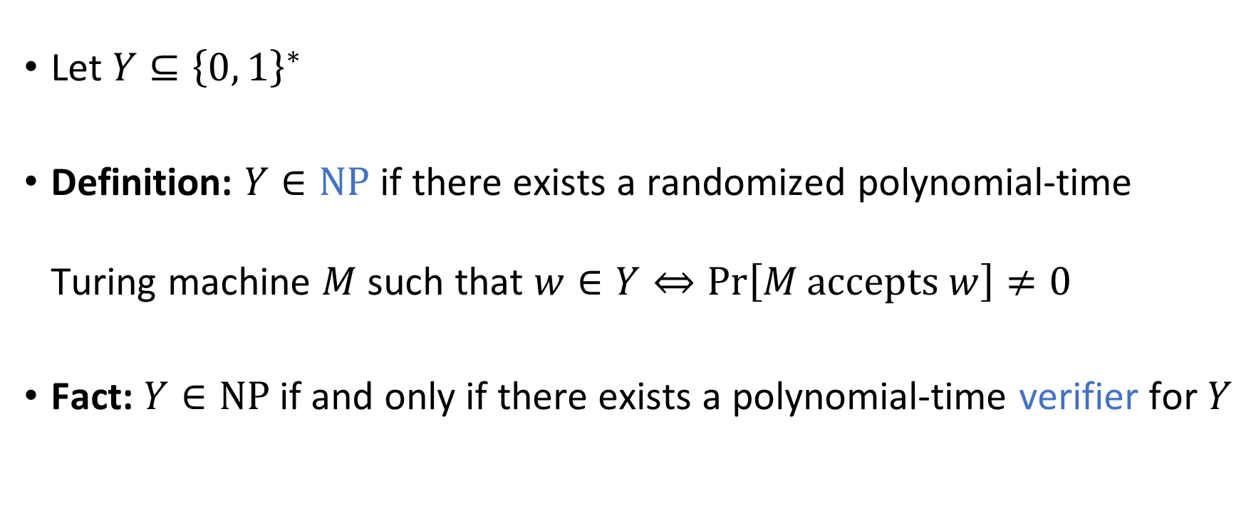

The complexity class $\text{NP}$
Let $Y⊆{\left\{0, 1\right\}}^{∗}$
Definition: $Y∈\text{NP}$ if there exists a randomized polynomial-time Turing machine $M$ such that $w∈Y⇔\operatorname{Pr}\left[M \text{accepts} w\right]≠0$
Fact: $Y∈\text{NP}$ if and only if there exists a polynomial-time verifier for $Y$

Slide 3

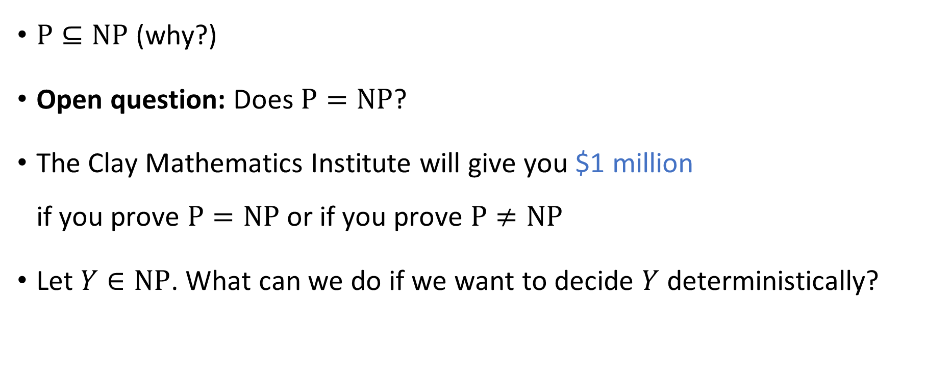


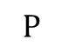
The $\text{P}$ vs. $\text{NP}$ problem
$$\text{NP}$$
$$\text{P}$$
$\text{P}⊆\text{NP}$ (why?)
Open question: Does $\text{P}=\text{NP}$?
The Clay Mathematics Institute will give you $1 million if you prove $\text{P}=\text{NP}$ or if you prove $\text{P}≠\text{NP}$
Let $Y∈\text{NP}$. What can we do if we want to decide $Y$ deterministically?

Slide 4
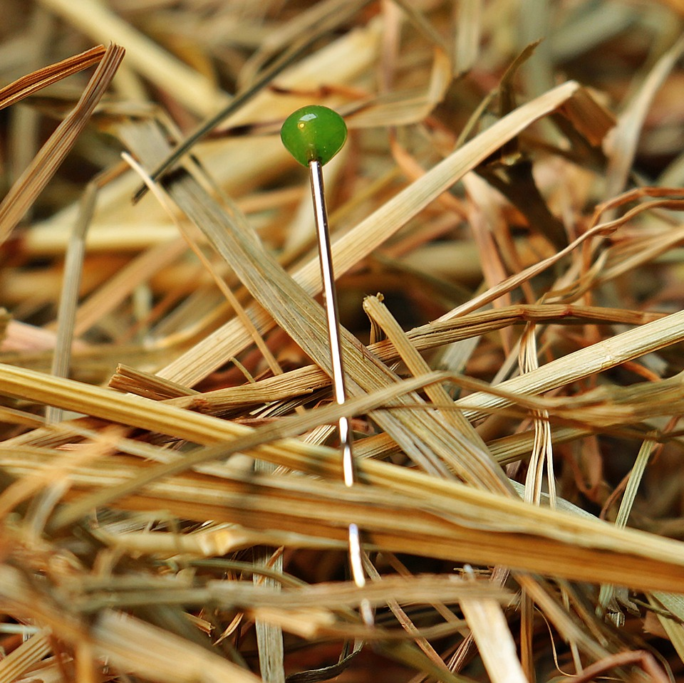
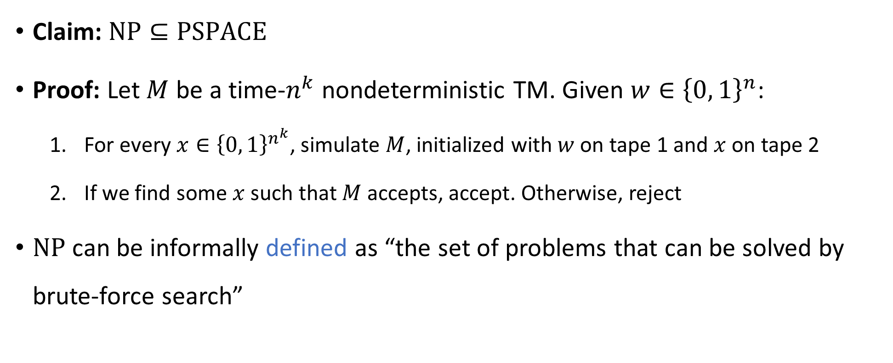

Solving problems in $\text{NP}$ by brute force
Claim: $\text{NP}⊆\text{PSPACE}$
Proof: Let $M$ be a time-$n^{k}$ nondeterministic TM. Given $w∈{\left\{0, 1\right\}}^{n}$:
For every $x∈{\left\{0, 1\right\}}^{n^{k}}$, simulate $M$, initialized with $w$ on tape 1 and $x$ on tape 2
If we find some $x$ such that $M$ accepts, accept. Otherwise, reject
$\text{NP}$ can be informally defined as “the set of problems that can be solved by brute-force search”

Slide 5

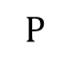


$$\text{EXP}$$
$$\text{PSPACE}$$
$$\text{NP}$$
$$\text{P}$$

Slide 6
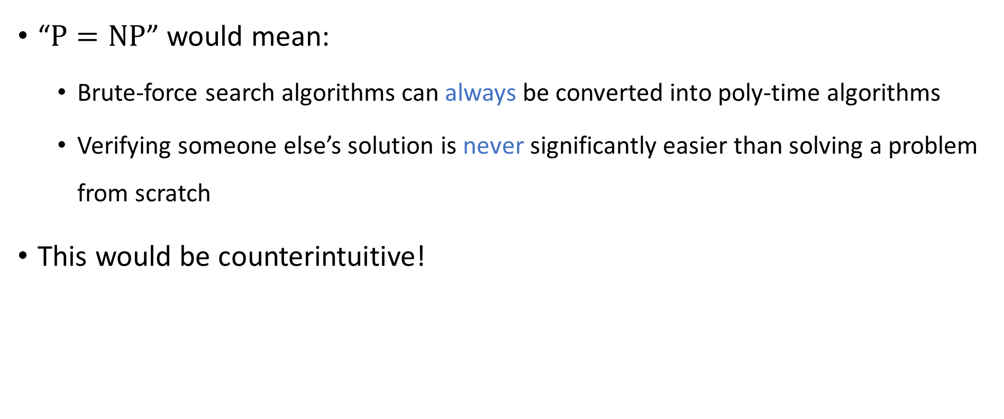
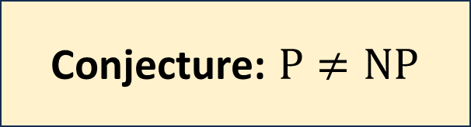
The $\text{P}$ vs. $\text{NP}$ problem
$$\text{NP}$$
$$\text{P}$$
“$\text{P}=\text{NP}$” would mean:
Brute-force search algorithms can always be converted into poly-time algorithms
Verifying someone else’s solution is never significantly easier than solving a problem from scratch
This would be counterintuitive!
Conjecture: $\text{P}≠\text{NP}$

Slide 7
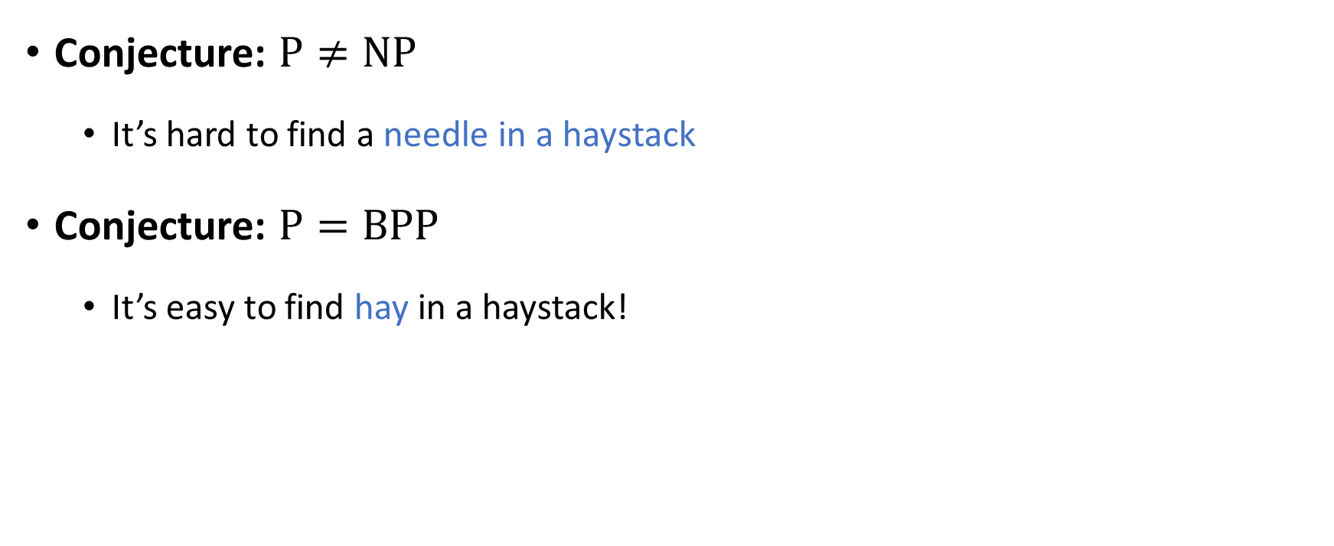

Comparing $\text{NP}$ and $\text{BPP}$
Conjecture: $\text{P}≠\text{NP}$
It’s hard to find a needle in a haystack
Conjecture: $\text{P}=\text{BPP}$
It’s easy to find hay in a haystack!

Slide 8
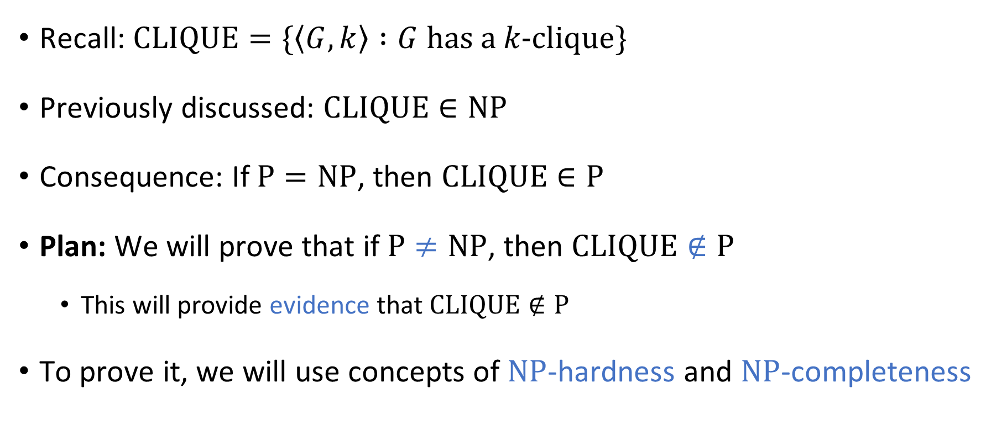

Complexity of $\text{CLIQUE}$
Recall: $\text{CLIQUE}=\{\left\langle G,k\right\rangle :G \text{has} \text{a} k\text{‑}\text{clique}\}$
Previously discussed: $\text{CLIQUE}∈\text{NP}$
Consequence: If $\text{P}=\text{NP}$, then $\text{CLIQUE}∈\text{P}$
Plan: We will prove that if $\text{P}≠\text{NP}$, then $\text{CLIQUE}∉\text{P}$
This will provide evidence that $\text{CLIQUE}∉\text{P}$
To prove it, we will use concepts of $\text{NP}$-hardness and $\text{NP}$-completeness

Slide 9
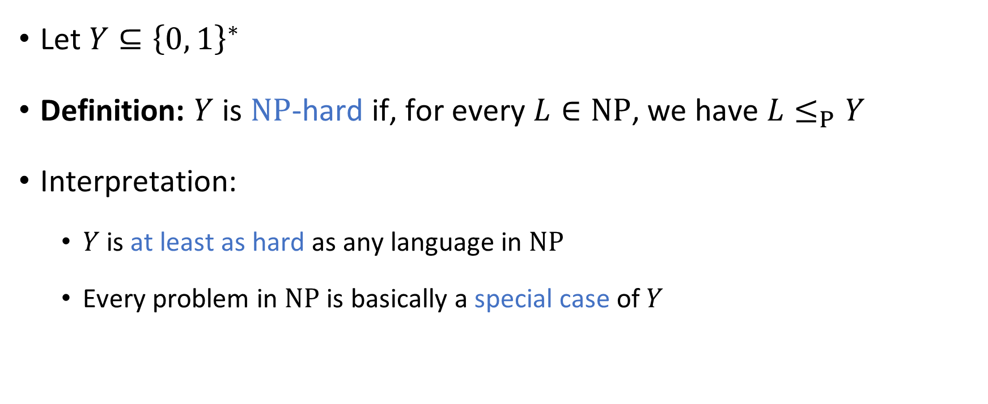
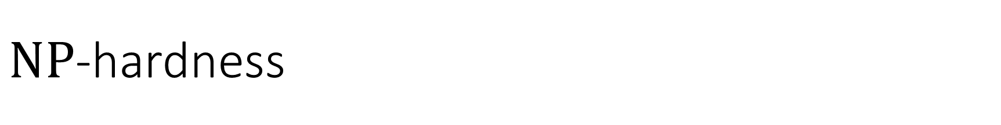
$\text{NP}$-hardness
Let $Y⊆{\left\{0, 1\right\}}^{∗}$
Definition: $Y$ is $\text{NP}$-hard if, for every $L∈\text{NP}$, we have $L≤_{P}Y$
Interpretation:
$Y$ is at least as hard as any language in $\text{NP}$
Every problem in $\text{NP}$ is basically a special case of $Y$

Slide 10
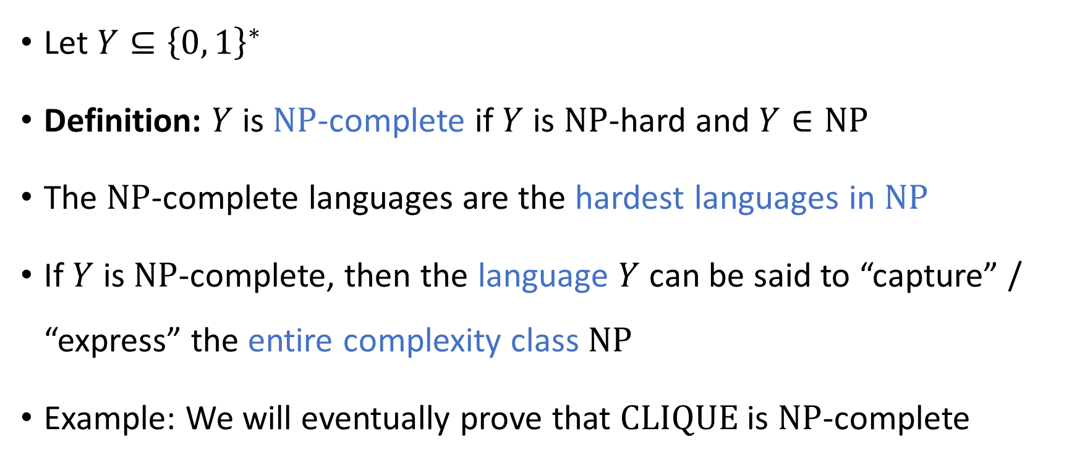
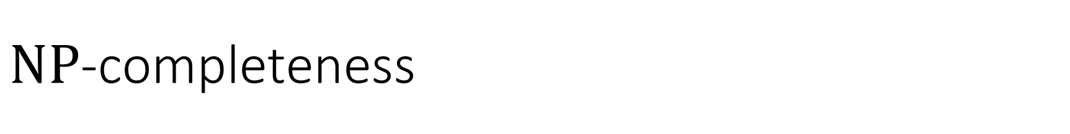
$\text{NP}$-completeness
Let $Y⊆{\left\{0, 1\right\}}^{∗}$
Definition: $Y$ is $\text{NP}$-complete if $Y$ is $\text{NP}$-hard and $Y∈\text{NP}$
The $\text{NP}$-complete languages are the hardest languages in $\text{NP}$
If $Y$ is $\text{NP}$-complete, then the language $Y$ can be said to “capture” / “express” the entire complexity class $\text{NP}$
Example: We will eventually prove that $\text{CLIQUE}$ is $\text{NP}$-complete

Slide 11
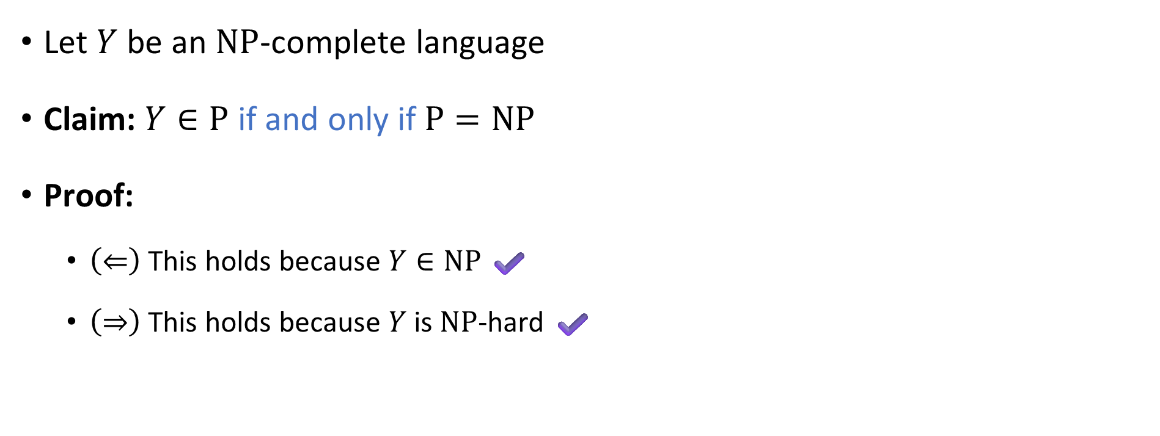

$\text{NP}$-complete languages are probably not in $\text{P}$
Let $Y$ be an $\text{NP}$-complete language
Claim: $Y∈\text{P}$ if and only if $\text{P}=\text{NP}$
Proof:
$\left(⇐\right)$ This holds because $Y∈\text{NP}$ ✔️
$\left(⇒\right)$ This holds because $Y$ is $\text{NP}$-hard ✔️

Slide 12
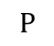
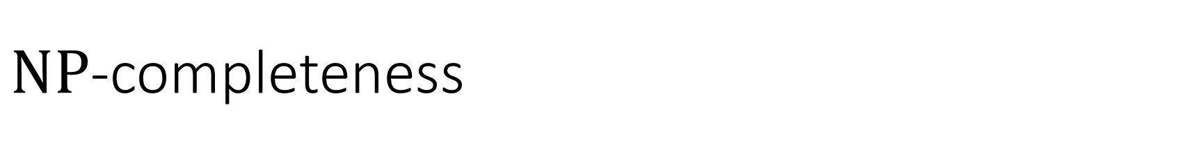
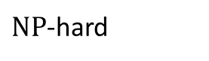


$\text{NP}$-completeness
$\text{NP}$-hard
$\text{NP}$-complete
$$\text{NP}$$
$$\text{P}$$

Slide 13
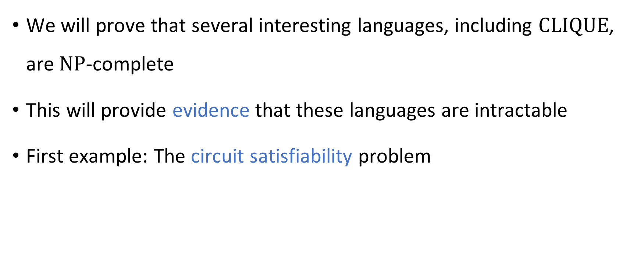

Proving $\text{NP}$-completeness
We will prove that several interesting languages, including $\text{CLIQUE}$, are $\text{NP}$-complete
This will provide evidence that these languages are intractable
First example: The circuit satisfiability problem

Slide 14

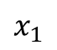

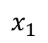

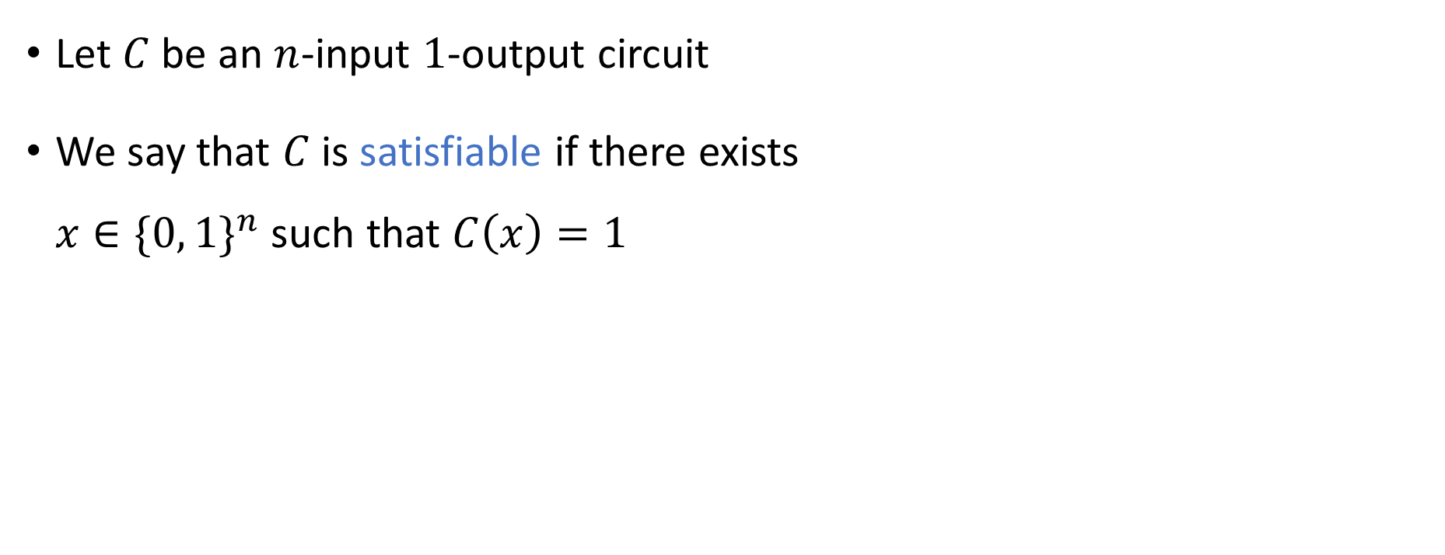




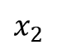
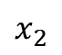


Circuit satisfiability
$$∨$$
$$∧$$
$$∧$$
Satisfiable ✔️
$$¬$$
Let $C$ be an $n$-input $1$-output circuit
We say that $C$ is satisfiable if there exists $x∈\{0, 1\}^{n}$ such that $C\left(x\right)=1$
$$x_{1}$$
$$x_{2}$$
$$∨$$
$$∧$$
$$∧$$
$$¬$$
Unsatisfiable ❌
$$¬$$
$$x_{1}$$
$$x_{2}$$

Slide 15
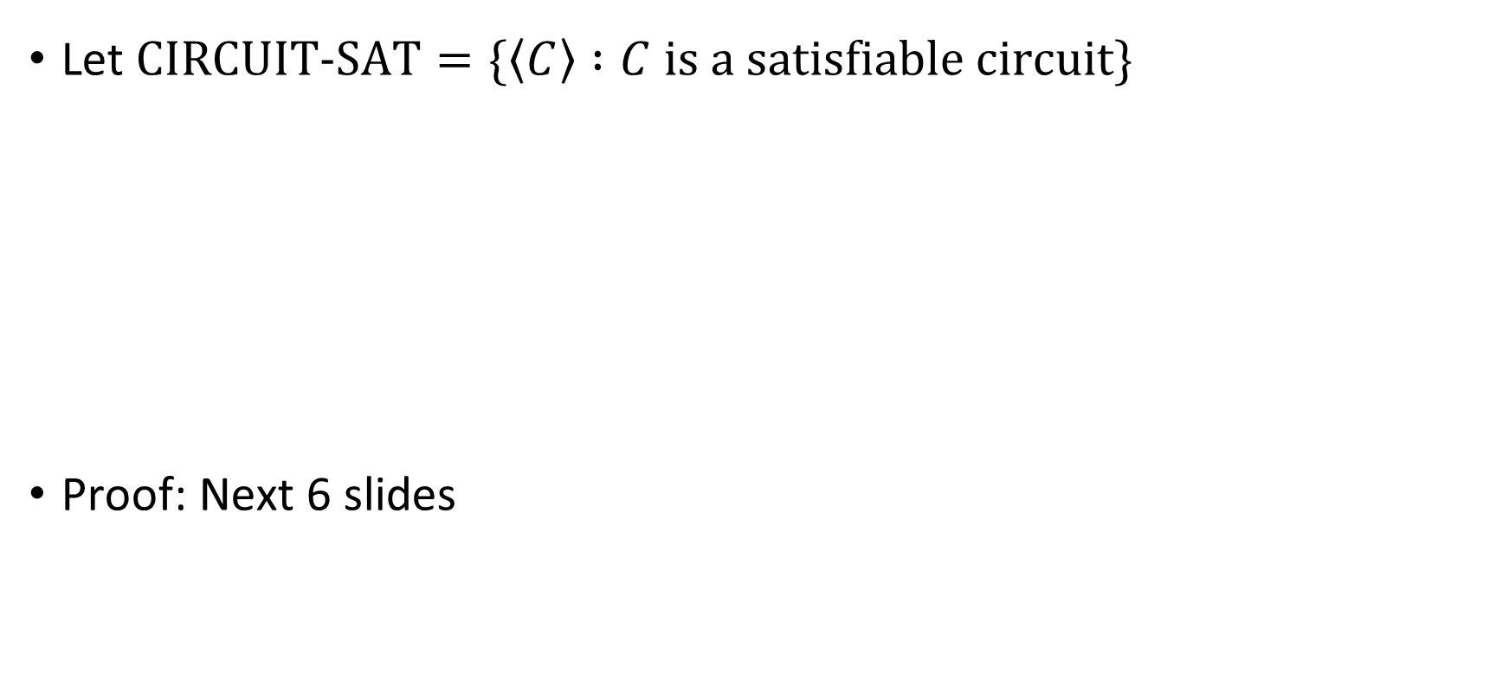


Circuit satisfiability is $\text{NP}$-complete
Let $\text{CIRCUIT}\text{‑}\text{SAT}=\{\left\langle C\right\rangle :C \text{is} \text{a} \text{satisfiable} \text{circuit}\}$
Proof: Next 6 slides
Theorem: $\text{CIRCUIT}\text{‑}\text{SAT}$ is $\text{NP}$-complete.

Slide 16
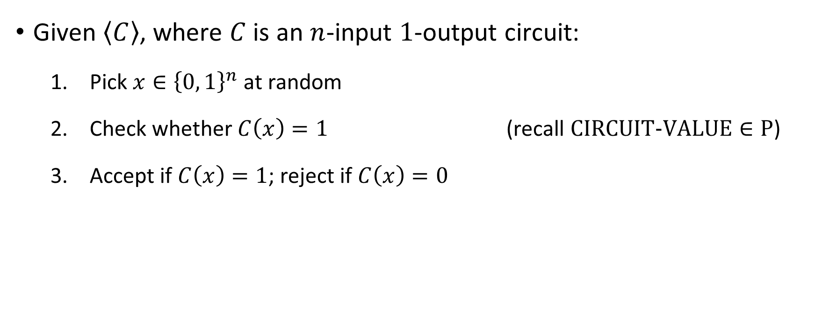

Proof that $\text{CIRCUIT}\text{‑}\text{SAT}∈\text{NP}$
Given $\left\langle C\right\rangle$, where $C$ is an $n$-input $1$-output circuit:
Pick $x∈{\left\{0, 1\right\}}^{n}$ at random
Check whether $C\left(x\right)=1$ (recall $\text{CIRCUIT}\text{‑}\text{VALUE}∈\text{P}$)
Accept if $C\left(x\right)=1$; reject if $C\left(x\right)=0$

Slide 17

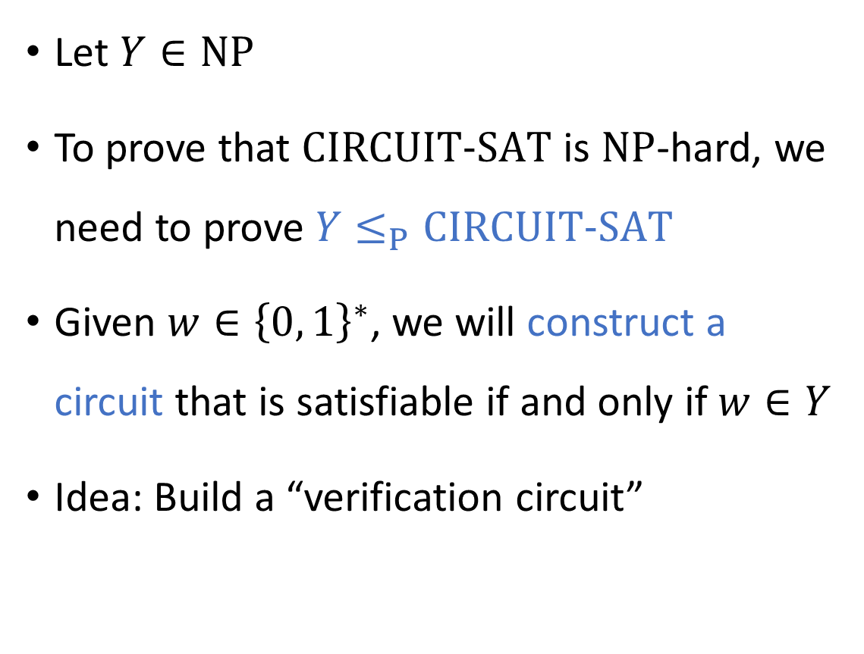
Code as data IV
Let $Y∈\text{NP}$
To prove that $\text{CIRCUIT}\text{‑}\text{SAT}$ is $\text{NP}$-hard, we need to prove $Y≤_{P}\text{CIRCUIT}\text{‑}\text{SAT}$
Given $w∈{\left\{0, 1\right\}}^{∗}$, we will construct a circuit that is satisfiable if and only if $w∈Y$
Idea: Build a “verification circuit”
“Drawing Hands.”
(1948 lithograph by M. C. Escher)

Slide 18
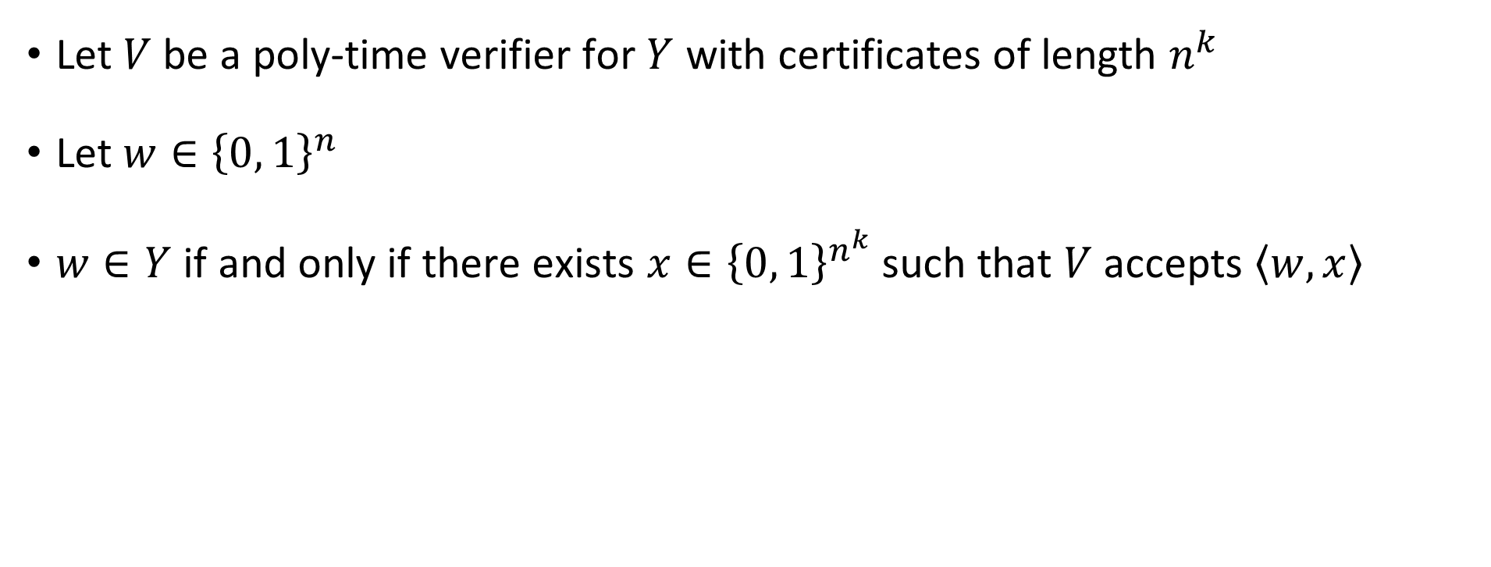
Constructing the verification circuit
Let $V$ be a poly-time verifier for $Y$ with certificates of length $n^{k}$
Let $w∈{\left\{0, 1\right\}}^{n}$
$w∈Y$ if and only if there exists $x∈{\left\{0, 1\right\}}^{n^{k}}$ such that $V$ accepts $\left\langle w,x\right\rangle$

Slide 19
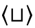


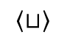
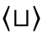

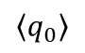
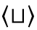
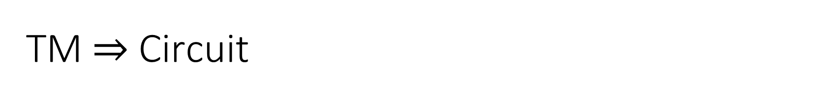

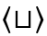

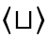


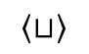
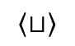
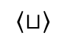
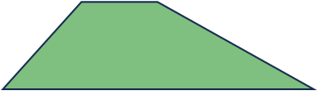
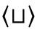
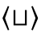

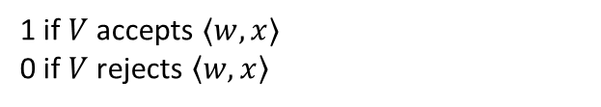


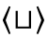
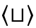
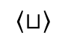

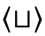


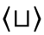

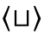
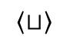











TM $⇒$ Circuit
1 if $V$ accepts $⟨w,x⟩$
0 if $V$ rejects $\left\langle w,x\right\rangle$
Step 1: Construct a circuit $C$ that simulates the verifier $V$
(Recall $\text{P}⊆\text{PSIZE}$ proof)
$$\left\langle ⊔\right\rangle$$
$$\left\langle ⊔\right\rangle$$
$$\left\langle ⊔\right\rangle$$
$$\left\langle ⊔\right\rangle$$
$$\left\langle ⊔\right\rangle$$
$$\left\langle ⊔\right\rangle$$
$$\left\langle ⊔\right\rangle$$
$$\left\langle ⊔\right\rangle$$
$$\left\langle ⊔\right\rangle$$
$$\left\langle ⊔\right\rangle$$
$$\left\langle ⊔\right\rangle$$
$$\left\langle ⊔\right\rangle$$
$$\left\langle ⊔\right\rangle$$
$$\left\langle ⊔\right\rangle$$
$$\left\langle ⊔\right\rangle$$
$$\left\langle ⊔\right\rangle$$
$$\left\langle ⊔\right\rangle$$
$$\left\langle ⊔\right\rangle$$
$$\left\langle ⊔\right\rangle$$
$$\left\langle ⊔\right\rangle$$
$$\left\langle ⊔\right\rangle$$
$$\left\langle ⊔\right\rangle$$
$$\left\langle ⊔\right\rangle$$
$$\left\langle ⊔\right\rangle$$
$$\left\langle ⊔\right\rangle$$
$$\left\langle ⊔\right\rangle$$
$$\left\langle ⊔\right\rangle$$
$$\left\langle ⊔\right\rangle$$
$$\left\langle ⊔\right\rangle$$
$$\left\langle ⊔\right\rangle$$
$$\left\langle ⊔\right\rangle$$
$$\left\langle ⊔\right\rangle$$
$$\left\langle ⊔\right\rangle$$
$$\left\langle ⊔\right\rangle$$
$$\left\langle q_{0}\right\rangle$$
$$0$$
$$\left\langle ⊔\right\rangle$$
$$\left\langle ⊔\right\rangle$$
$$\left\langle ⊔\right\rangle$$
$$\left\langle ⊔\right\rangle$$
$$0$$
$$0$$
$$0$$
$$0$$
$$0$$
$$\left\langle w,x\right\rangle$$

Slide 20



TM $⇒$ Circuit
Step 1: Construct a circuit $C$ that simulates the verifier $V$
(Recall $\text{P}⊆\text{PSIZE}$ proof)
$$C$$
$$\left\langle w,x\right\rangle$$

Slide 21















Step 2: Hard-coding
Poly-time computable ✔️
YES maps to YES: If $w∈Y$, then $C^{′}$ is satisfiable ✔️
NO maps to NO: If $w∉Y$, then $C^{′}$ is not satisfiable ✔️
$$C$$
$$C′$$
$$\left\langle w,x\right\rangle$$
$$1$$
$$1$$
$$1$$
$$0$$
$$1$$
$$0$$
$$1$$
$$x_{1}$$
$$x_{2}$$
$$x_{3}$$
$$x_{4}$$
$$w$$
Hard-code the original input $w$, so the input to $C^{′}$ is $x$ (certificate)
(Recall $\text{P}/\text{poly}⊆\text{PSIZE}$ proof)
Technical detail: Use the encoding $\left\langle w,x\right\rangle =1^{|w|}0wx$
Reduction: $Ψ\left(w\right)=\left\langle C^{′}\right\rangle$

Slide 22

Theorem: $\text{CIRCUIT}\text{‑}\text{SAT}$ is $\text{NP}$-complete.
Make sure you thoroughly understand this theorem and its proof!
A ton of key concepts from this course come together here!

Slide 23

$\text{NP}$-completeness
$\text{NP}$-hard
$$\text{CIRCUIT}\text{‑}\text{SAT}$$
$\text{NP}$-complete
$$\text{NP}$$
$$\text{P}$$

Slide 24



What else is $\text{NP}$-complete?
We showed that $\text{CIRCUIT}\text{‑}\text{SAT}$ is $\text{NP}$-complete
This will help us to prove that other problems, such as $\text{CLIQUE}$, are also $\text{NP}$-complete
Idea: Chain reductions together

Slide 25

Chaining reductions together
Claim: If $Y_{1}≤_{P}Y_{2}≤_{P}Y_{3}$, then $Y_{1}≤_{P}Y_{3}$
Proof: Let $Ψ_{1→2}$ and $Ψ_{2→3}$ be the mapping reductions
Reduction from $Y_{1}$ to $Y_{3}$ is $Ψ\left(w\right)=Ψ_{2→3}\left(Ψ_{1→2}\left(w\right)\right)$
YES maps to YES ✔️
NO maps to NO ✔️
Poly-time computable, because $\left|Ψ_{1→2}\left(w\right)\right|≤\text{poly}\left(\left|w\right|\right)$

Slide 26










Chaining reductions together
$$Ψ_{1→2}$$
$$Ψ_{2→3}$$
$$Y_{2}$$
$$Y_{1}$$
$$Y_{3}$$
$$Ψ_{1→2}$$
$$Ψ_{2→3}$$
$${\left\{0, 1\right\}}^{∗}$$
$${\left\{0, 1\right\}}^{∗}$$
$${\left\{0, 1\right\}}^{∗}$$

